Slide 1
It’s time to level up!

Slide 2
3. Tensor = a collection of vectors and covectors combined together using the tensor product
Notes:
More advanced… You’ve possibly never heard of a covector. Possibly never heard of the tensor product before. But this definition is really nice because we only really need to understand 3 things. We know almost all the basics

Slide 3
The Tensor Product
Part 1: Vector-Covector Pairs
Warning: Video contains
non-standard tensor product notation

Slide 4




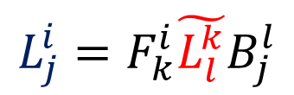



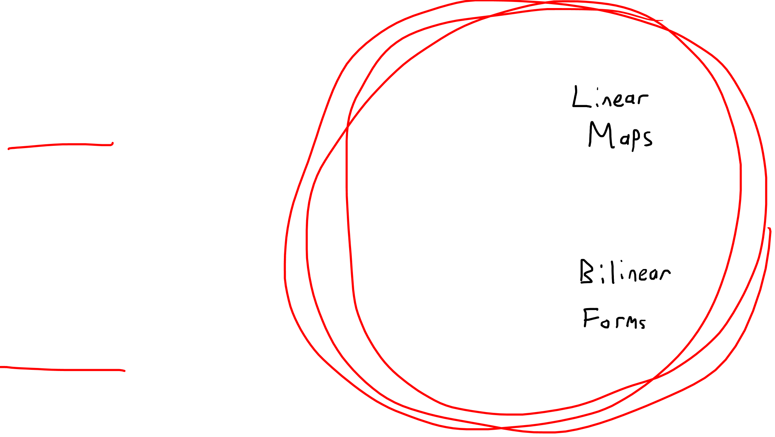



Contravariant (1,0)-Tensor
(1,1)-Tensor
$$\tilde{ε^{i}} =B_{j}^{i}ε^{j}$$
$$\tilde{v^{i}}=B_{j}^{i}v^{j}$$
$$\tilde{L_{j}^{i}}=B_{k}^{i}L_{l}^{k}F_{j}^{l}$$
$$ε^{i}=F_{j}^{i}\tilde{ε^{j}}$$
$$v^{i}=F_{j}^{i}\tilde{v^{j}}$$
$$L_{j}^{i}=F_{k}^{i}\tilde{L_{l}^{k}}B_{j}^{l}$$
Covariant (0,1)-Tensor
(0,2)-Tensor
$$\tilde{\vec{e_{j}}}=F_{j}^{i}\vec{e_{i}}$$
$$\tilde{α_{j}}=F_{j}^{i}α_{i}$$
$$\tilde{ℬ_{ij}}=F_{i}^{k}F_{j}^{l}ℬ_{kl}$$
$$ℬ_{kl}=B_{k}^{i}B_{l}^{j}\tilde{ℬ_{ij}}$$
$$\vec{e_{j}}=B_{j}^{i}\tilde{\vec{e_{i}}}$$
$$α_{j}=B_{j}^{i}\tilde{α_{i}}$$

Slide 5

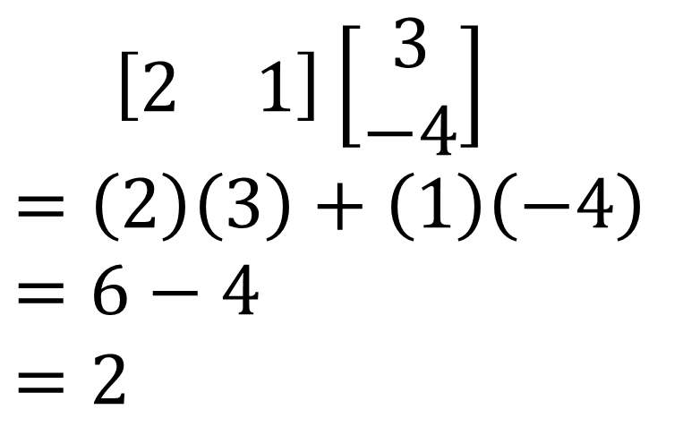
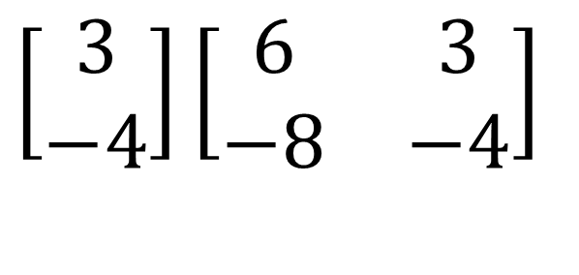

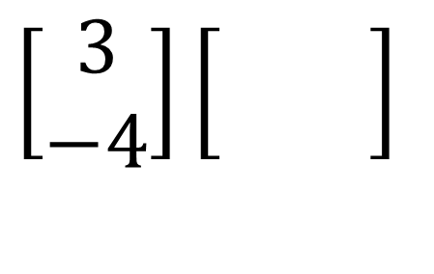
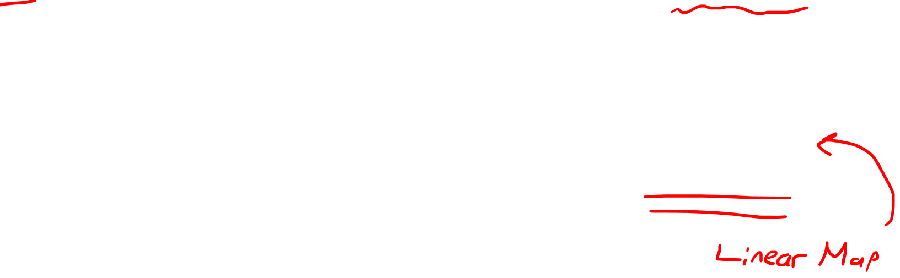
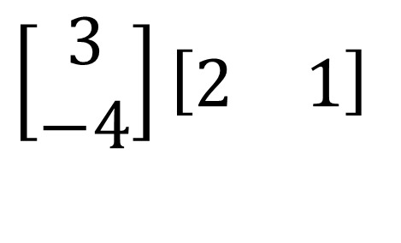
$\left[\begin{matrix}2 & 1\end{matrix}\right]\left[\begin{matrix}3 \\ −4\end{matrix}\right]$
$$=\left(2\right)\left(3\right)+\left(1\right)\left(−4\right)$$
$$=6−4$$
$$=2$$
$$\left[\begin{matrix}3 \\ −4\end{matrix}\right]\left[\begin{matrix}2 & 1\end{matrix}\right]$$
$$\left[\begin{matrix}2 & 1\end{matrix}\right]$$
$$\left[\begin{matrix}3 \\ −4\end{matrix}\right]\left[\begin{matrix}\begin{aligned} \\ \end{aligned} & \begin{aligned} \\ \end{aligned}\end{matrix}\right]$$
$$\left[\begin{matrix}2 & 1\end{matrix}\right]$$
$$\left[\begin{matrix}3 \\ −4\end{matrix}\right]\left[\begin{matrix}\begin{aligned}6 \\ −8\end{aligned} & \begin{aligned}3 \\ −4\end{aligned}\end{matrix}\right]$$

Slide 6
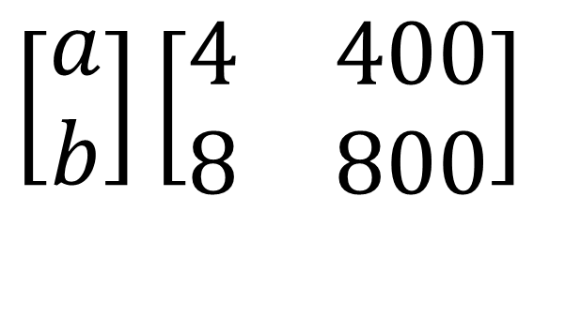
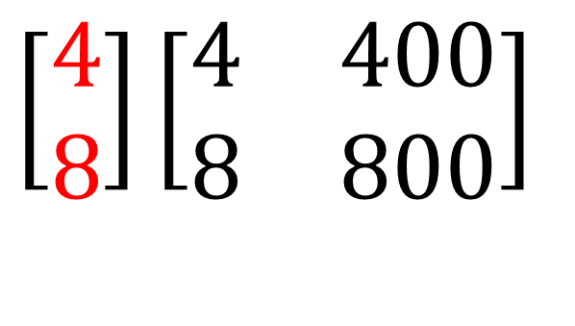


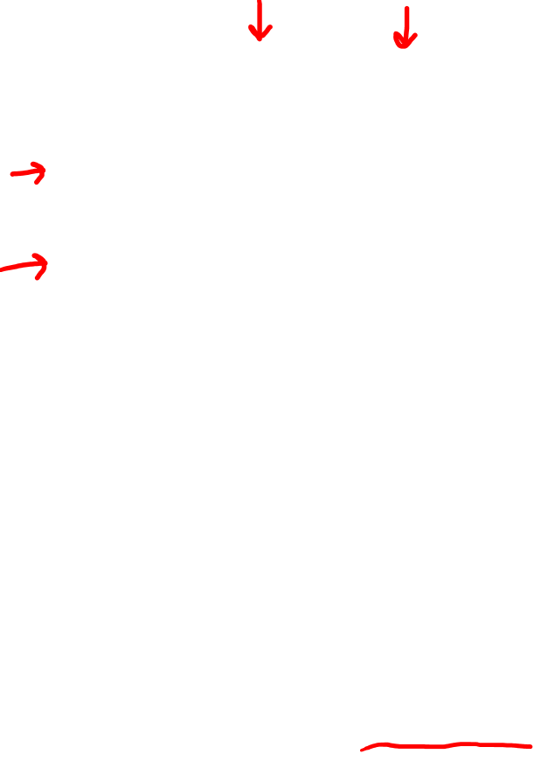
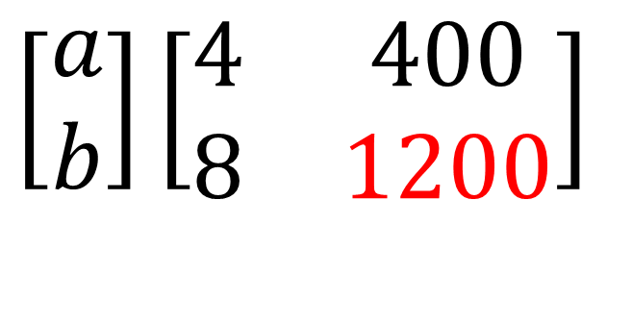


$$\left[\begin{matrix}c & d\end{matrix}\right]$$
$$\left[\begin{matrix}1 & 100\end{matrix}\right]$$
$$\left[\begin{matrix}a \\ b\end{matrix}\right]\left[\begin{matrix}\begin{aligned}4 \\ 8\end{aligned} & \begin{aligned}400 \\ 800\end{aligned}\end{matrix}\right]$$
$$\left[\begin{matrix}4 \\ 8\end{matrix}\right]\left[\begin{matrix}\begin{aligned}4 \\ 8\end{aligned} & \begin{aligned}400 \\ 800\end{aligned}\end{matrix}\right]$$
$$\left[\begin{matrix}c & d\end{matrix}\right]$$
$$\left[\begin{matrix}a \\ b\end{matrix}\right]\left[\begin{matrix}\begin{aligned}4 \\ 8\end{aligned} & \begin{aligned}400 \\ 1200\end{aligned}\end{matrix}\right]$$
$$Impossible!$$

Slide 7
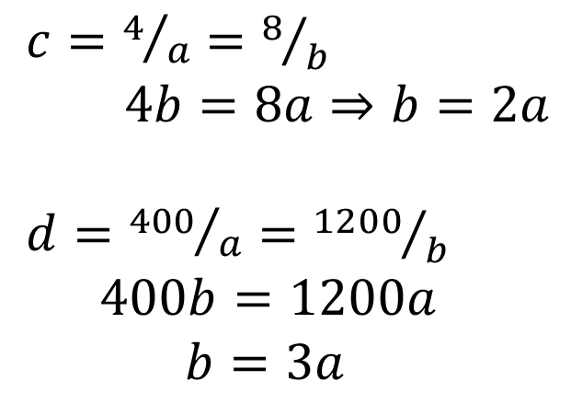
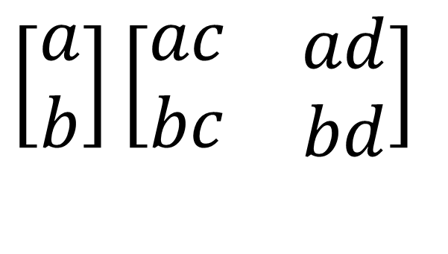
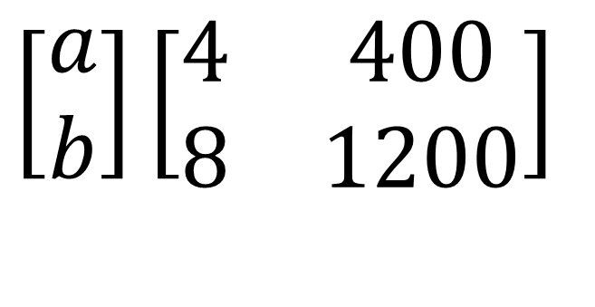

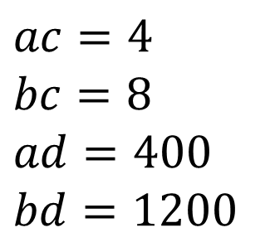

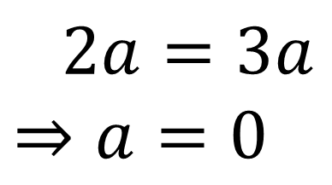
$$\left[\begin{matrix}c & d\end{matrix}\right]$$
$$\left[\begin{matrix}c & d\end{matrix}\right]$$
$$\left[\begin{matrix}a \\ b\end{matrix}\right]\left[\begin{matrix}\begin{aligned}4 \\ 8\end{aligned} & \begin{aligned}400 \\ 1200\end{aligned}\end{matrix}\right]$$
$$\left[\begin{matrix}a \\ b\end{matrix}\right]\left[\begin{matrix}\begin{aligned}ac \\ bc\end{aligned} & \begin{aligned}ad \\ bd\end{aligned}\end{matrix}\right]$$
$$ac=4$$
$$bc=8$$
$$ad=400$$
$$bd=1200$$
$c=4/a=8/b$
$4b=8a⇒b=2a$
$d={400}/a={1200}/b$
$400b=1200a$
$b=3a$
$2a=3a$ $⇒a=0$

Slide 8

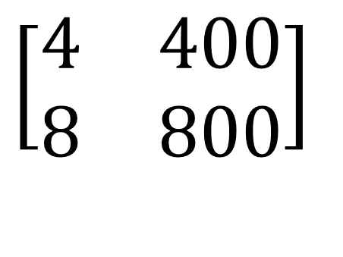


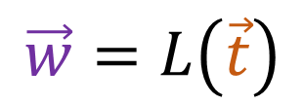
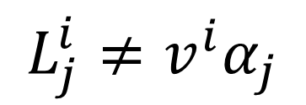
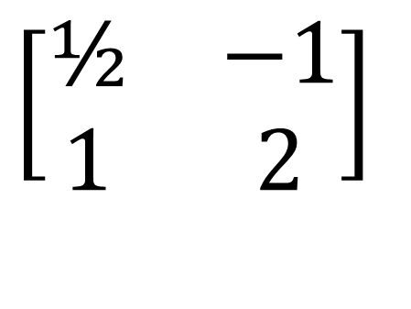




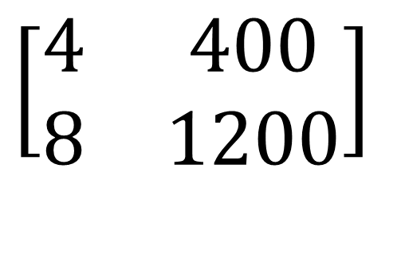
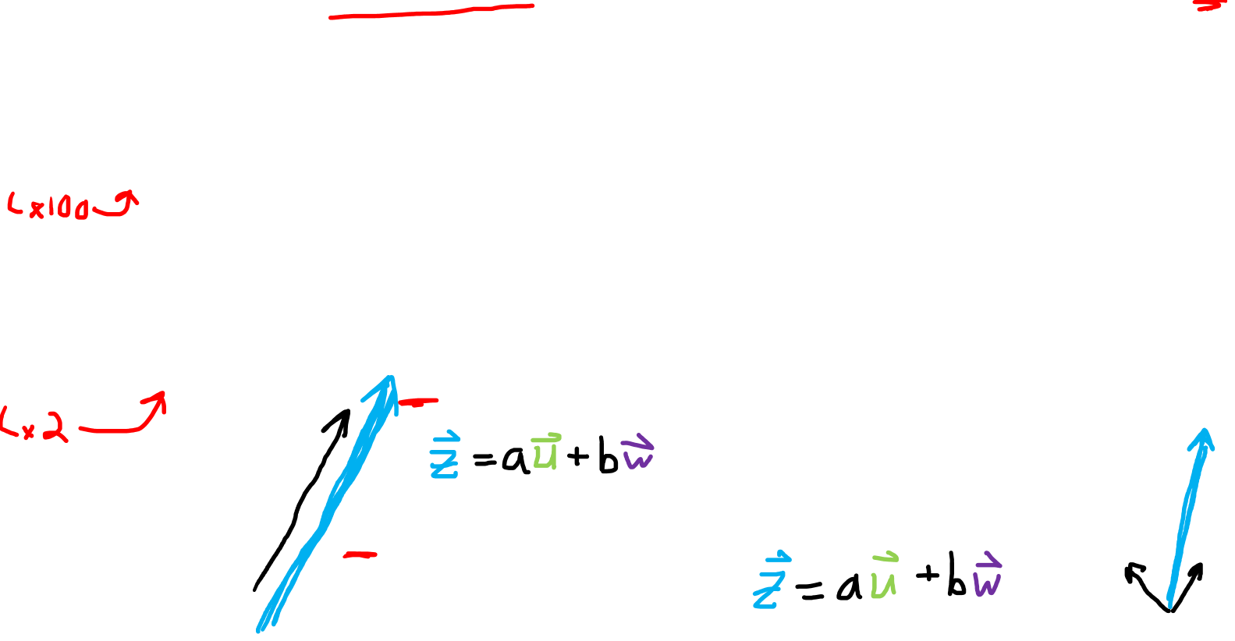

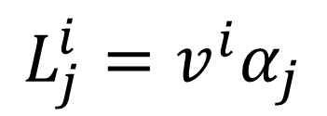

Impure
Pure
$$L_{j}^{i}≠v^{i}α_{j}$$
$$L_{j}^{i}=v^{i}α_{j}$$
$$\left[\begin{matrix}\begin{aligned}4 \\ 8\end{aligned} & \begin{aligned}400 \\ 800\end{aligned}\end{matrix}\right]$$
$$\left[\begin{matrix}\begin{aligned}4 \\ 8\end{aligned} & \begin{aligned}400 \\ 1200\end{aligned}\end{matrix}\right]$$
$$\left[\begin{matrix}\begin{aligned}\text{½} \\ 1\end{aligned} & \begin{aligned}1 \\ 2\end{aligned}\end{matrix}\right]$$
$$\left[\begin{matrix}\begin{aligned}\text{½} \\ 1\end{aligned} & \begin{aligned}−1 \\ 2\end{aligned}\end{matrix}\right]$$
$$\vec{w}=L\left(\vec{t}\right)$$
$$\vec{w}=L\left(\vec{t}\right)$$
$$\vec{t}$$
$$\vec{t}$$
$$\vec{u}=L\left(\vec{v}\right)$$
$$\vec{u}=L\left(\vec{v}\right)$$
$$\vec{v}$$
$$\vec{v}$$

Slide 9


$$\{\vec{e_{1}},\vec{e_{2}}\}$$
$$\{ε^{1},ε^{2}\}$$

Slide 10
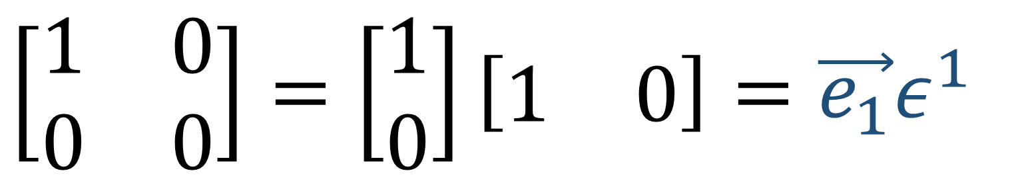

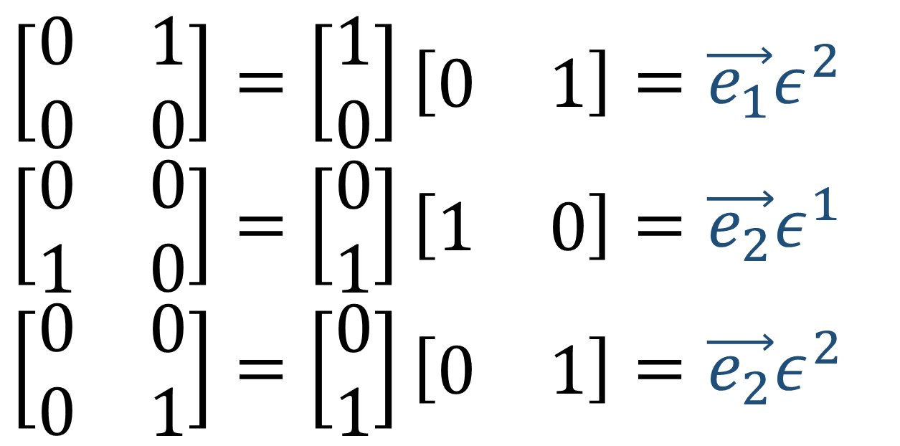
$$\left[\begin{matrix}\begin{aligned}1 \\ 0\end{aligned} & \begin{aligned}0 \\ 0\end{aligned}\end{matrix}\right]=\left[\begin{aligned}1 \\ 0\end{aligned}\right]\left[\begin{matrix}1 & 0\end{matrix}\right]=\vec{e_{1}}ε^{1}$$
$$\left[\begin{matrix}\begin{aligned}0 \\ 0\end{aligned} & \begin{aligned}1 \\ 0\end{aligned}\end{matrix}\right]=\left[\begin{aligned}1 \\ 0\end{aligned}\right]\left[\begin{matrix}0 & 1\end{matrix}\right]=\vec{e_{1}}ε^{2}$$
$$\left[\begin{matrix}\begin{aligned}0 \\ 1\end{aligned} & \begin{aligned}0 \\ 0\end{aligned}\end{matrix}\right]=\left[\begin{aligned}0 \\ 1\end{aligned}\right]\left[\begin{matrix}1 & 0\end{matrix}\right]=\vec{e_{2}}ε^{1}$$
$$\left[\begin{matrix}\begin{aligned}0 \\ 0\end{aligned} & \begin{aligned}0 \\ 1\end{aligned}\end{matrix}\right]=\left[\begin{aligned}0 \\ 1\end{aligned}\right]\left[\begin{matrix}0 & 1\end{matrix}\right]=\vec{e_{2}}ε^{2}$$

Slide 11

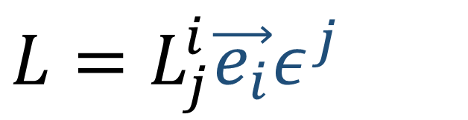
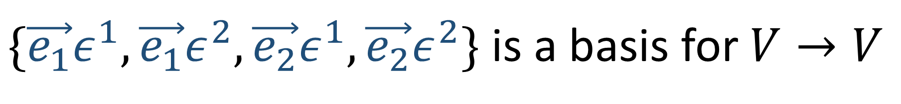
$$a\left[\begin{matrix}\begin{aligned}1 \\ 0\end{aligned} & \begin{aligned}0 \\ 0\end{aligned}\end{matrix}\right]+b\left[\begin{matrix}\begin{aligned}0 \\ 0\end{aligned} & \begin{aligned}1 \\ 0\end{aligned}\end{matrix}\right]+c\left[\begin{matrix}\begin{aligned}0 \\ 1\end{aligned} & \begin{aligned}0 \\ 0\end{aligned}\end{matrix}\right]+d\left[\begin{matrix}\begin{aligned}0 \\ 0\end{aligned} & \begin{aligned}0 \\ 1\end{aligned}\end{matrix}\right]=\left[\begin{matrix}\begin{aligned}a \\ c\end{aligned} & \begin{aligned}b \\ d\end{aligned}\end{matrix}\right]$$
$\{\vec{e_{1}}ε^{1},\vec{e_{1}}ε^{2},\vec{e_{2}}ε^{1},\vec{e_{2}}ε^{2}\}$ is a basis for $V→V$
$$L=a\vec{e_{1}}ε^{1}+b\vec{e_{1}}ε^{2}+c\vec{e_{2}}ε^{1}+d\vec{e_{2}}ε^{2}$$
$$L=L_{j}^{i}\vec{e_{i}}ε^{j}$$

Slide 12
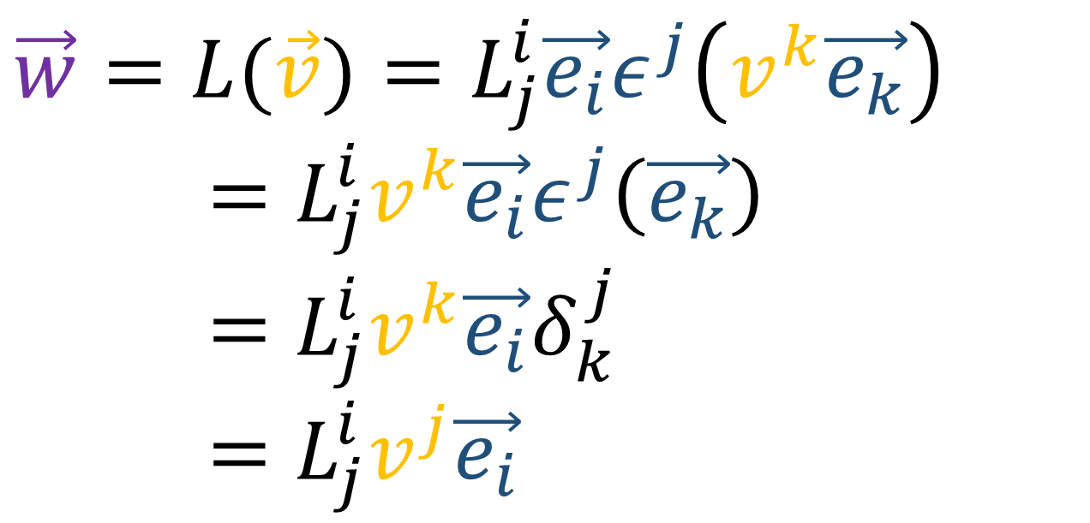
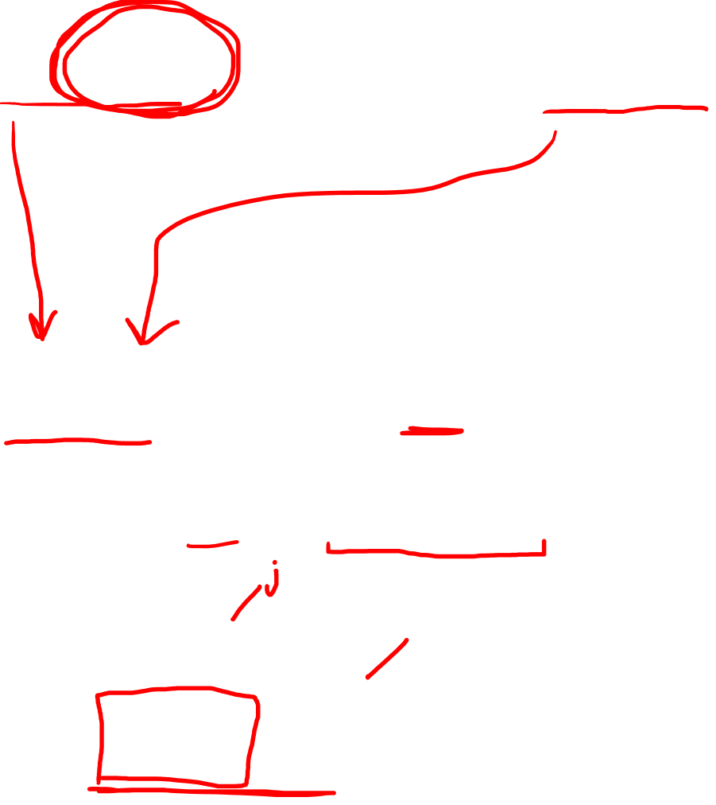
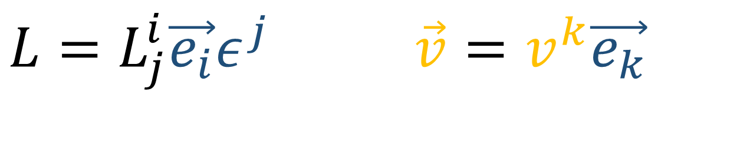

$$L=L_{j}^{i}\vec{e_{i}}ε^{j} \vec{v}=v^{k}\vec{e_{k}}$$
$$\vec{w}=L\left(\vec{v}\right)$$
$$w^{i}=L_{j}^{i}v^{j}$$
$\vec{w}=L(\vec{v})=L_{j}^{i}\vec{e_{i}}ε^{j}\left(v^{k}\vec{e_{k}}\right)$
$=L_{j}^{i}v^{k}\vec{e_{i}}ε^{j}\left(\vec{e_{k}}\right)$
$=L_{j}^{i}v^{k}\vec{e_{i}}δ_{k}^{j}$
$=L_{j}^{i}v^{j}\vec{e_{i}}$

Slide 13

$$a\left[\begin{matrix}\begin{aligned}1 \\ 0\end{aligned} & \begin{aligned}0 \\ 0\end{aligned}\end{matrix}\right]+b\left[\begin{matrix}\begin{aligned}0 \\ 0\end{aligned} & \begin{aligned}1 \\ 0\end{aligned}\end{matrix}\right]+c\left[\begin{matrix}\begin{aligned}0 \\ 1\end{aligned} & \begin{aligned}0 \\ 0\end{aligned}\end{matrix}\right]+d\left[\begin{matrix}\begin{aligned}0 \\ 0\end{aligned} & \begin{aligned}0 \\ 1\end{aligned}\end{matrix}\right]=\left[\begin{matrix}\begin{aligned}a \\ c\end{aligned} & \begin{aligned}b \\ d\end{aligned}\end{matrix}\right]$$
$\{\vec{e_{1}}ε^{1},\vec{e_{1}}ε^{2},\vec{e_{2}}ε^{1},\vec{e_{2}}ε^{2}\}$ is a basis for $V→V$

Slide 14


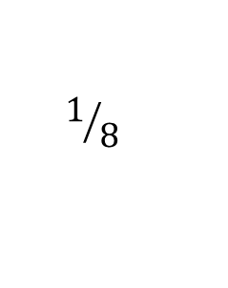
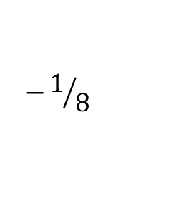
$$a\left[\begin{matrix}\begin{aligned}\text{½} \\ \text{¼}\end{aligned} & \begin{aligned}1 \\ \text{½}\end{aligned}\end{matrix}\right]+b\left[\begin{matrix}\begin{aligned}−2 \\ −1\end{aligned} & \begin{aligned}4 \\ 2\end{aligned}\end{matrix}\right]+c\left[\begin{matrix}\begin{aligned}−1 \\ \end{aligned} & \begin{aligned}−\text{¼} \\ \end{aligned}\end{matrix}\right]+d\left[\begin{matrix}\begin{aligned}\text{½} \\ −\text{¼}\end{aligned} & \begin{aligned}−1 \\ \text{½}\end{aligned}\end{matrix}\right]=\left[\begin{matrix}\begin{aligned}w \\ y\end{aligned} & \begin{aligned}x \\ z\end{aligned}\end{matrix}\right]$$
$$−1/8$$
$$1/{16}$$
$$1/8$$
$\{\vec{e_{1}}ε^{1},\vec{e_{1}}ε^{2},\vec{e_{2}}ε^{1},\vec{e_{2}}ε^{2}\}$ is a basis for $V→V$

Slide 15
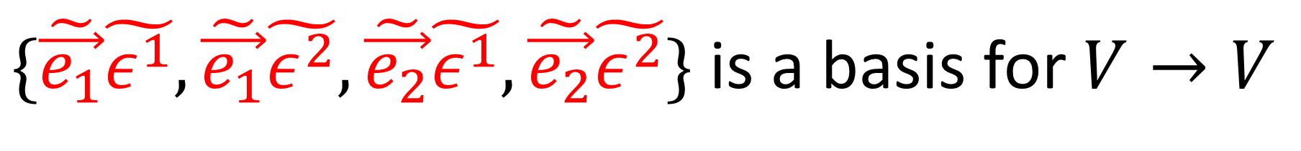
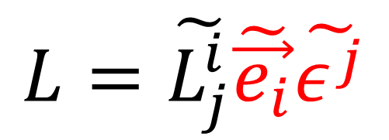
$$a\left[\begin{matrix}\begin{aligned}\text{½} \\ \text{¼}\end{aligned} & \begin{aligned}1 \\ \text{½}\end{aligned}\end{matrix}\right]+b\left[\begin{matrix}\begin{aligned}−2 \\ −1\end{aligned} & \begin{aligned}4 \\ 2\end{aligned}\end{matrix}\right]+c\left[\begin{matrix}\begin{aligned}−1 \\ \end{aligned} & \begin{aligned}−\text{¼} \\ \end{aligned}\end{matrix}\right]+d\left[\begin{matrix}\begin{aligned}\text{½} \\ −\text{¼}\end{aligned} & \begin{aligned}−1 \\ \text{½}\end{aligned}\end{matrix}\right]=\left[\begin{matrix}\begin{aligned}w \\ y\end{aligned} & \begin{aligned}x \\ z\end{aligned}\end{matrix}\right]$$
$$−1/8$$
$$1/{16}$$
$$1/8$$
$\{\tilde{\vec{e_{1}}}\tilde{ε^{1}},\tilde{\vec{e_{1}}}\tilde{ε^{2}},\tilde{\vec{e_{2}}}\tilde{ε^{1}},\tilde{\vec{e_{2}}}\tilde{ε^{2}}\}$ is a basis for $V→V$
$$L=\tilde{L_{1}^{1}}\tilde{\vec{e_{1}}}\tilde{ε^{1}}+\tilde{L_{2}^{1}}\tilde{\vec{e_{1}}}\tilde{ε^{2}}+\tilde{L_{1}^{2}}\tilde{\vec{e_{2}}}\tilde{ε^{1}}+\tilde{L_{2}^{2}}\tilde{\vec{e_{2}}}\tilde{ε^{2}}$$
$$L=\tilde{L_{j}^{i}}\tilde{\vec{e_{i}}}\tilde{ε^{j}}$$

Slide 16
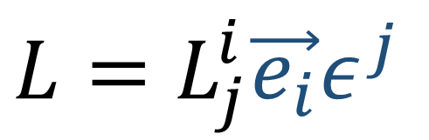



Linear Maps = Vector-Covector Pairs!
$$\left[\begin{matrix}2 & 1\end{matrix}\right]$$
$$\left[\begin{matrix}3 \\ −4\end{matrix}\right]\left[\begin{matrix}\begin{aligned}6 \\ −8\end{aligned} & \begin{aligned}3 \\ −4\end{aligned}\end{matrix}\right]$$
$$a\left[\begin{matrix}\begin{aligned}1 \\ 0\end{aligned} & \begin{aligned}0 \\ 0\end{aligned}\end{matrix}\right]+b\left[\begin{matrix}\begin{aligned}0 \\ 0\end{aligned} & \begin{aligned}1 \\ 0\end{aligned}\end{matrix}\right]+c\left[\begin{matrix}\begin{aligned}0 \\ 1\end{aligned} & \begin{aligned}0 \\ 0\end{aligned}\end{matrix}\right]+d\left[\begin{matrix}\begin{aligned}0 \\ 0\end{aligned} & \begin{aligned}0 \\ 1\end{aligned}\end{matrix}\right]=\left[\begin{matrix}\begin{aligned}a \\ c\end{aligned} & \begin{aligned}b \\ d\end{aligned}\end{matrix}\right]$$
Impure
Pure
$$\vec{e_{i}}ε^{j}(\vec{v})$$
$=\vec{e_{i}}ε^{j}\left(v^{k}\vec{e_{k}}\right)$
$$=v^{k}\vec{e_{i}}ε^{j}\left(\vec{e_{k}}\right)$$
$$=v^{k}\vec{e_{i}}δ_{k}^{j}$$
$$=v^{j}\vec{e_{i}}$$
$$L=L_{j}^{i}\vec{e_{i}}ε^{j}$$

Slide 17



$$\vec{e_{i}}ε^{j}$$
$$\vec{e_{i}}⊗ε^{j}$$
Tensor Product of Vector and Covector

Slide 18
$$\vec{e_{i}}ε^{j}$$
$$\vec{e_{i}}⊗ε^{j}$$
Tensor Product of Vector and Covector

